Slide 1

6636 final project: Credit Card Client Attrition Prediction Using Machine Learning
Cong Lyu

Slide 2
Background
Customer retention is crucial to a company’s profitability and growth.
5 to 25 times
More expensive to acquire a new customer
25% to 95%
Increased profits from 5% increase in retention rates
Harvard Business Review
The Value of Keeping the Right Customers (hbr.org)

Slide 3
Objectives
Identify key factors influencing customer attrition.
Develop predictive models to identify customers at a higher risk of attrition.
Evaluate model performance and utilize model parameters to gain insights for proactive retention strategies.

Slide 4
Dataset
10,127 Customers
23 Columns
Demographic and Account Information, Financial Behaviors
Perform EDA

Slide 5
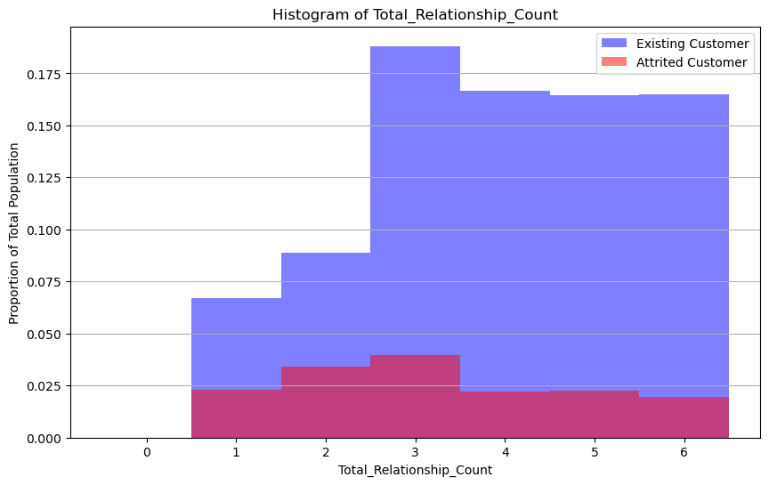
Distribution of number of product held by customer

Slide 6
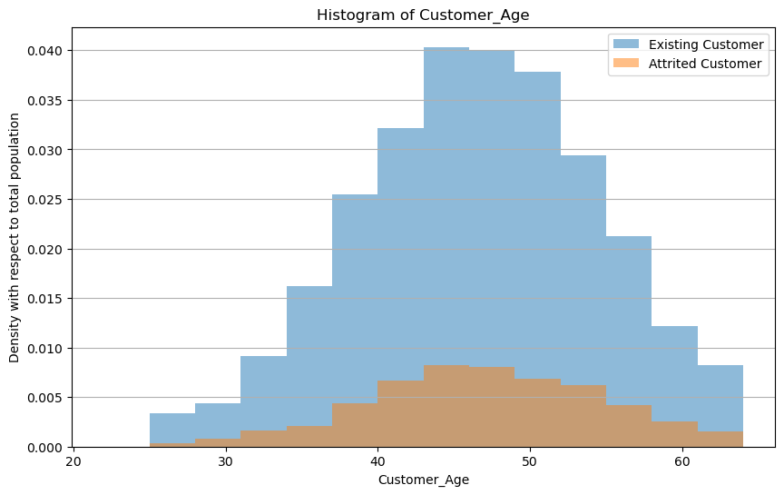
Distribution of age of customer

Slide 7
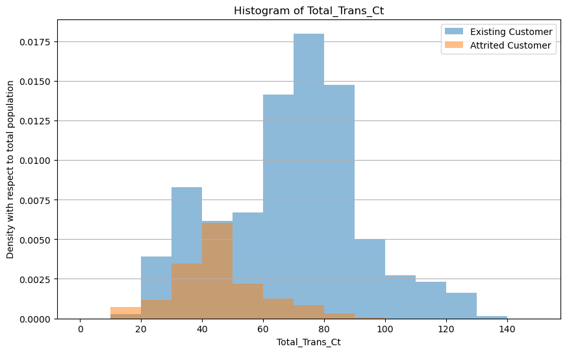
Distribution of total customer transactions

Slide 8
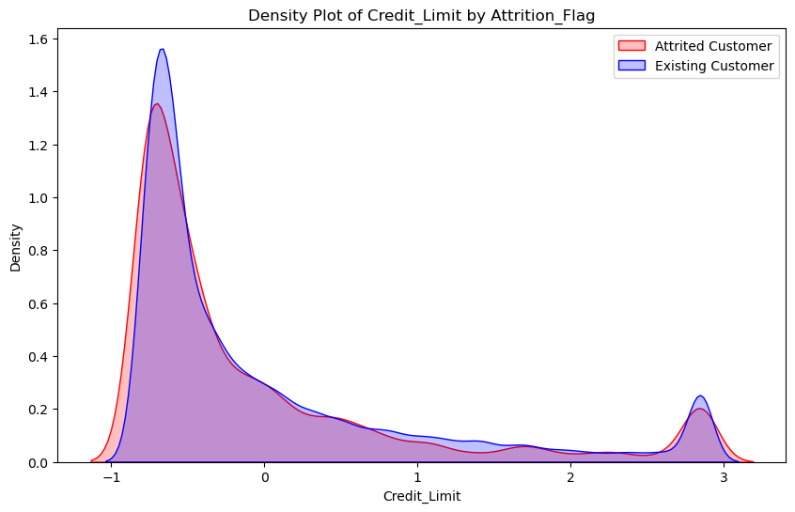
Distribution of credit limit

Slide 9
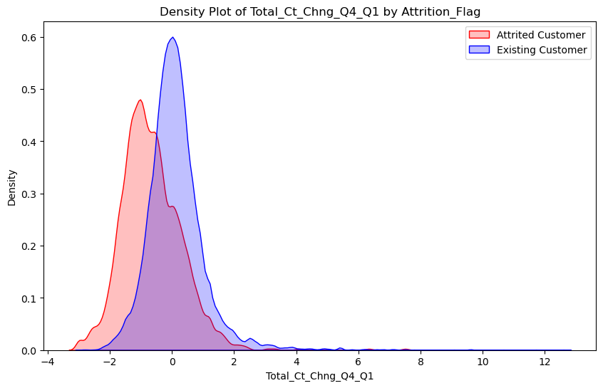
Distribution of change in transaction count (Q4 over Q1)

Slide 10
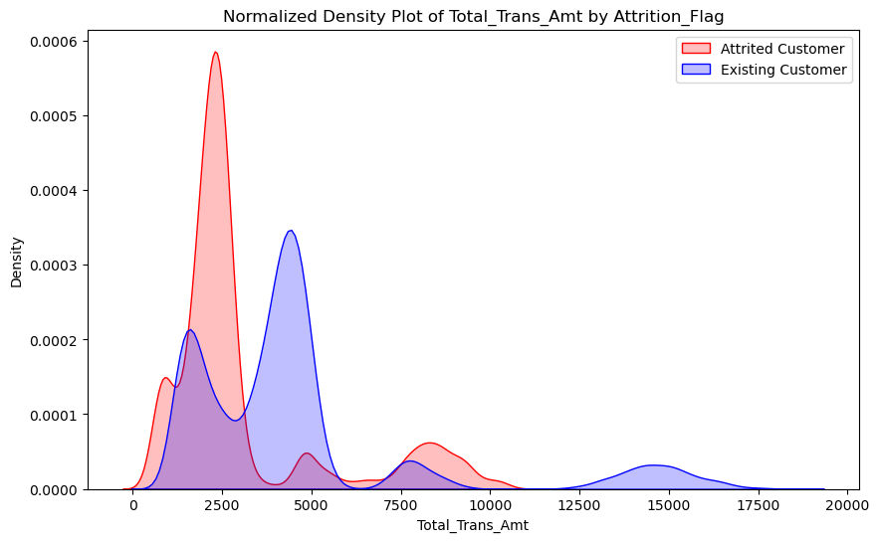
Distribution of total transaction amount

Slide 11
Data Preprocess
Factorize Categorical Variables
Standardize Decimal Variables
Convert attrition flag for model training
0 = Existing, 1 = Attrited Customers
Randomly split data
60% training, 20% validation, 20% test

Slide 12

Using 5 models to predict Attrition
1. SVM
2. GLM(saturated & reduced model)
3. Decision Tree(with GridCV to find best depth and number of split)
4. Random Forest
5. Neural Network

Slide 13
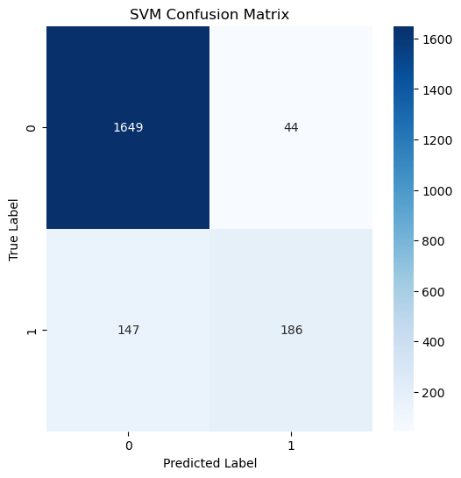
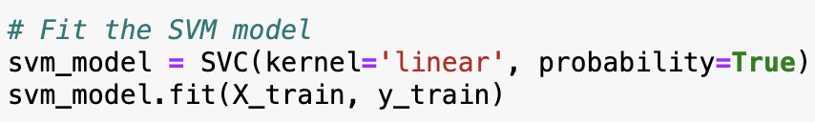
Fit A SVM Model To Predict Attrition
The high False Negatives (FN) shows that the model is better at identifying the non-churn customers than the churn customers.

Slide 14
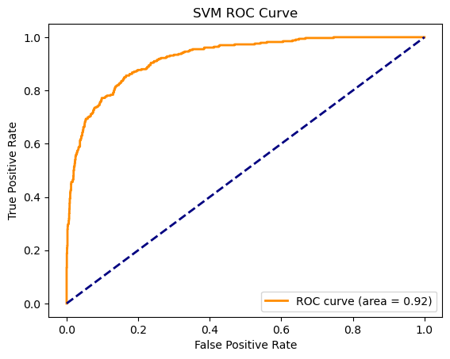
SVM performance
The ROC curve for the SVM model has an Area Under Curve (AUC) of 0.92. This is a strong score and suggests that the model has a good measure of separability.
The curve stays significantly above the diagonal line of no-discrimination, which is the line that represents a random guess.

Slide 15
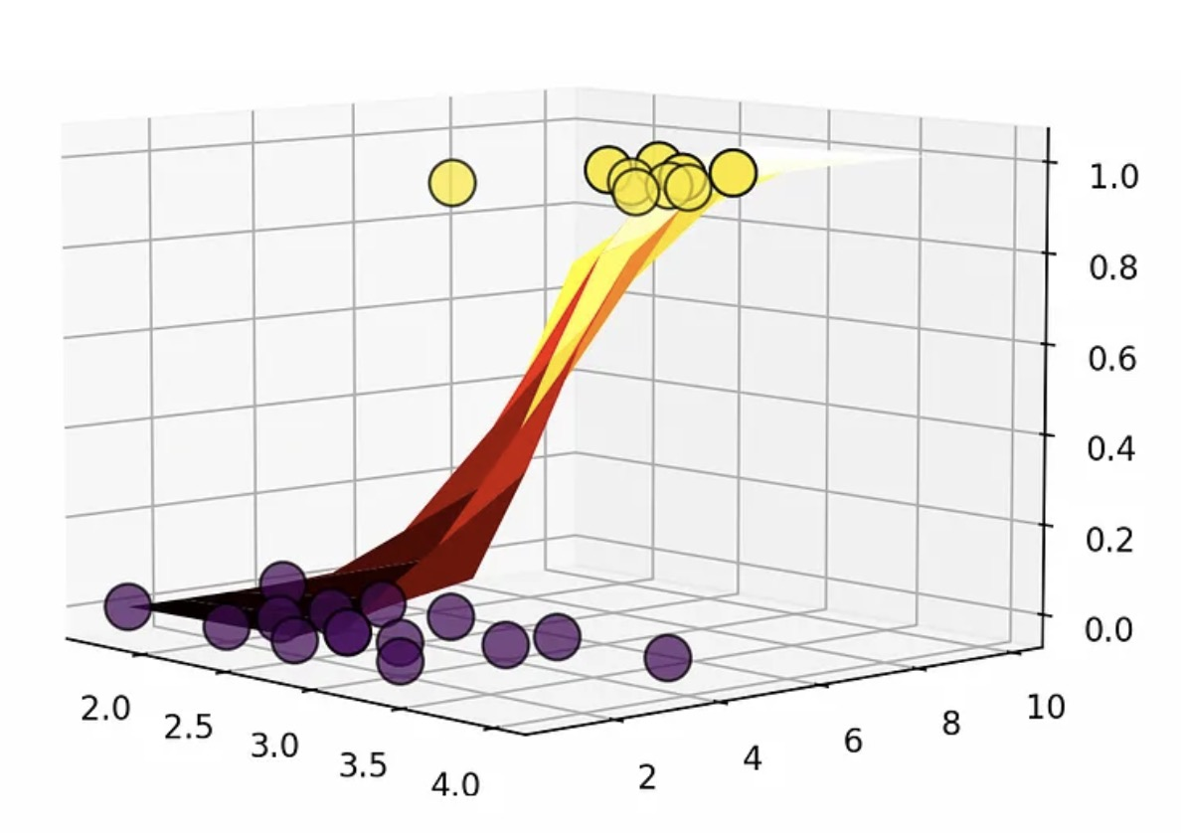
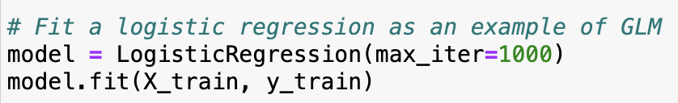
Fit A GLM Model To Predict Attrition
Use LogisticRegression provided by sklearn.linear_model to fit the data
GLM advantages:
Powerful in distinguishing binary response
Variables interpretable
What is so general about Generalized Linear Model? | by Ayan Kundu | Towards Data Science

Slide 16
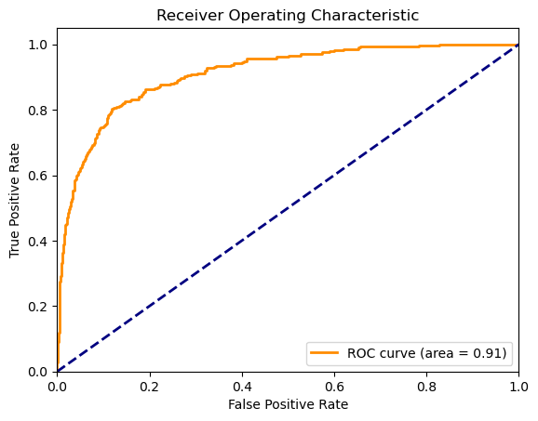
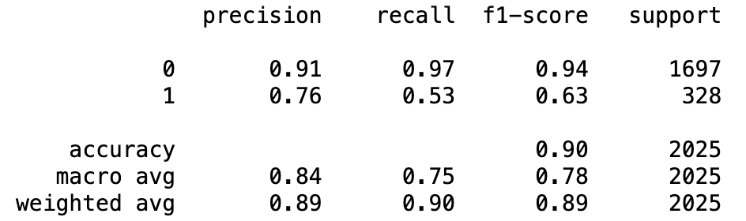
Check the Model Performance
Compute ROC curve and ROC area for the validation set
Use confusion matrix to test the accuracy

Slide 17
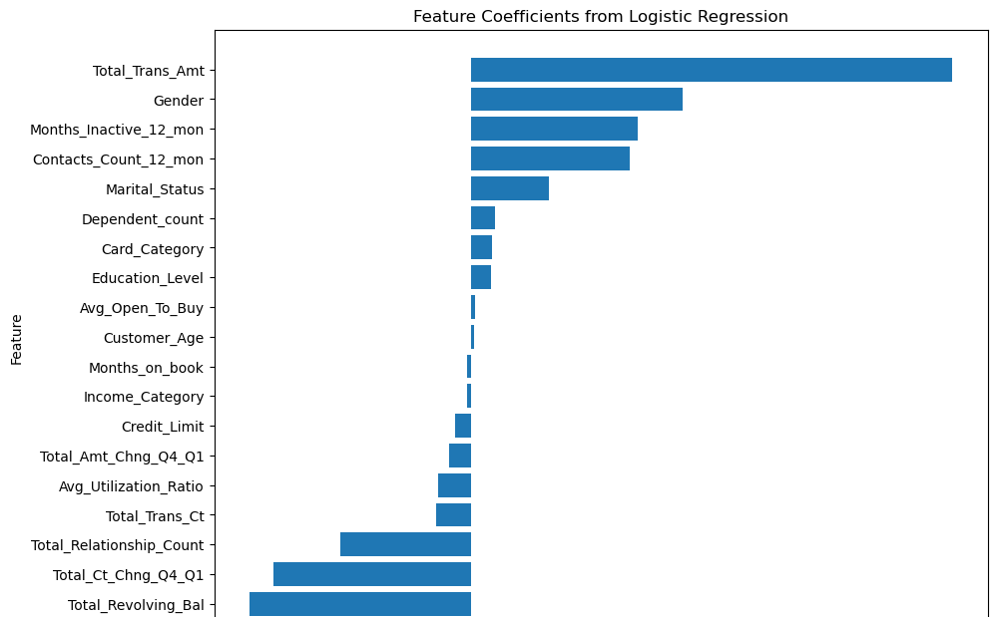
Model Coefficient Analysis
+
-
Decrease the likelihood of attrition
Increase the likelihood of attrition

Slide 18
Top Factors Increasing Likelihood of Attrition
Total Transaction Amount
(1.566514)
Gender
(0.688676)
Months Inactive 12 months
(0.541984)
Contacts Count 12 months
(0.515431)
Strongest positive impact
Higher spending customers are more likely to leave
Gender has a significant impact on attrition
Female customer may be more likely to leave
Longer inactivity periods increase the likelihood of attrition
More frequent contacts with the bank in the last year

Slide 19
Top Factors Decreasing Likelihood of Attrition
Total Revolving Balance
(-0.724191)
Strongest negative predictor of attrition
Higher balances are less likely to leave
Total Ct Chng Q4 to Q1
(-0.645265)
Increased transaction count reduces attrition
Total Relationship Count
(-0.427701)
Customers with more products are less likely to leave

Slide 20
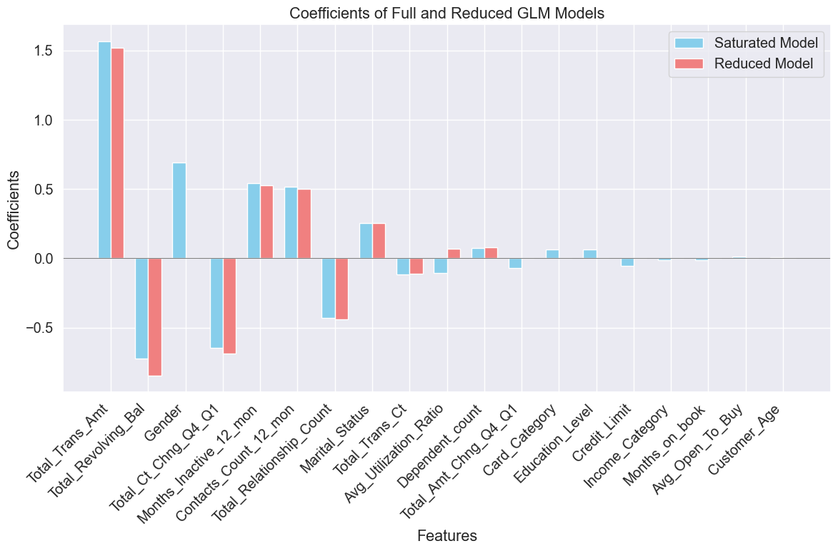
Reducing Non-significant Variables: Forward And Backward Selection
Use SequentialFeatureSelector from mlxtend package
Examine the parameters selected by the model and compare with the complete model

Slide 21
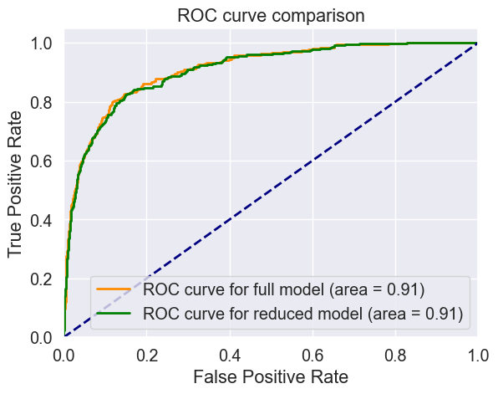
Model Accuracy: Full Vs Reduced Model

Slide 22
Supervised Learning Methods: Decision Tree & Random Forest
Train
Train Decision Tree & Random Forest Models
Identify Important Features
Evaluate
Evaluate Model Performance
Compare
Compare Results
Provide
Provide Business Insights
Identify

Slide 23
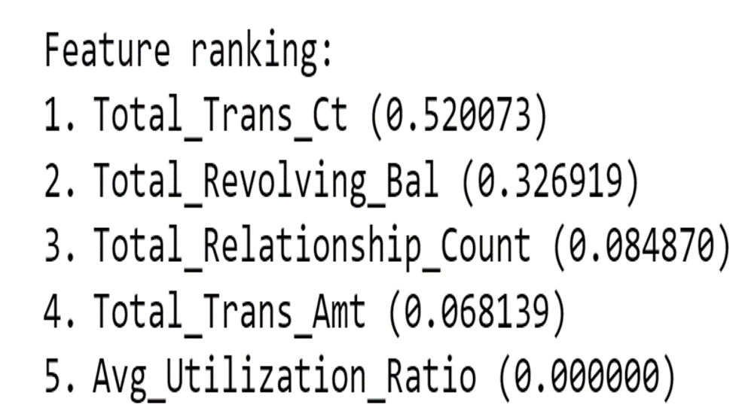
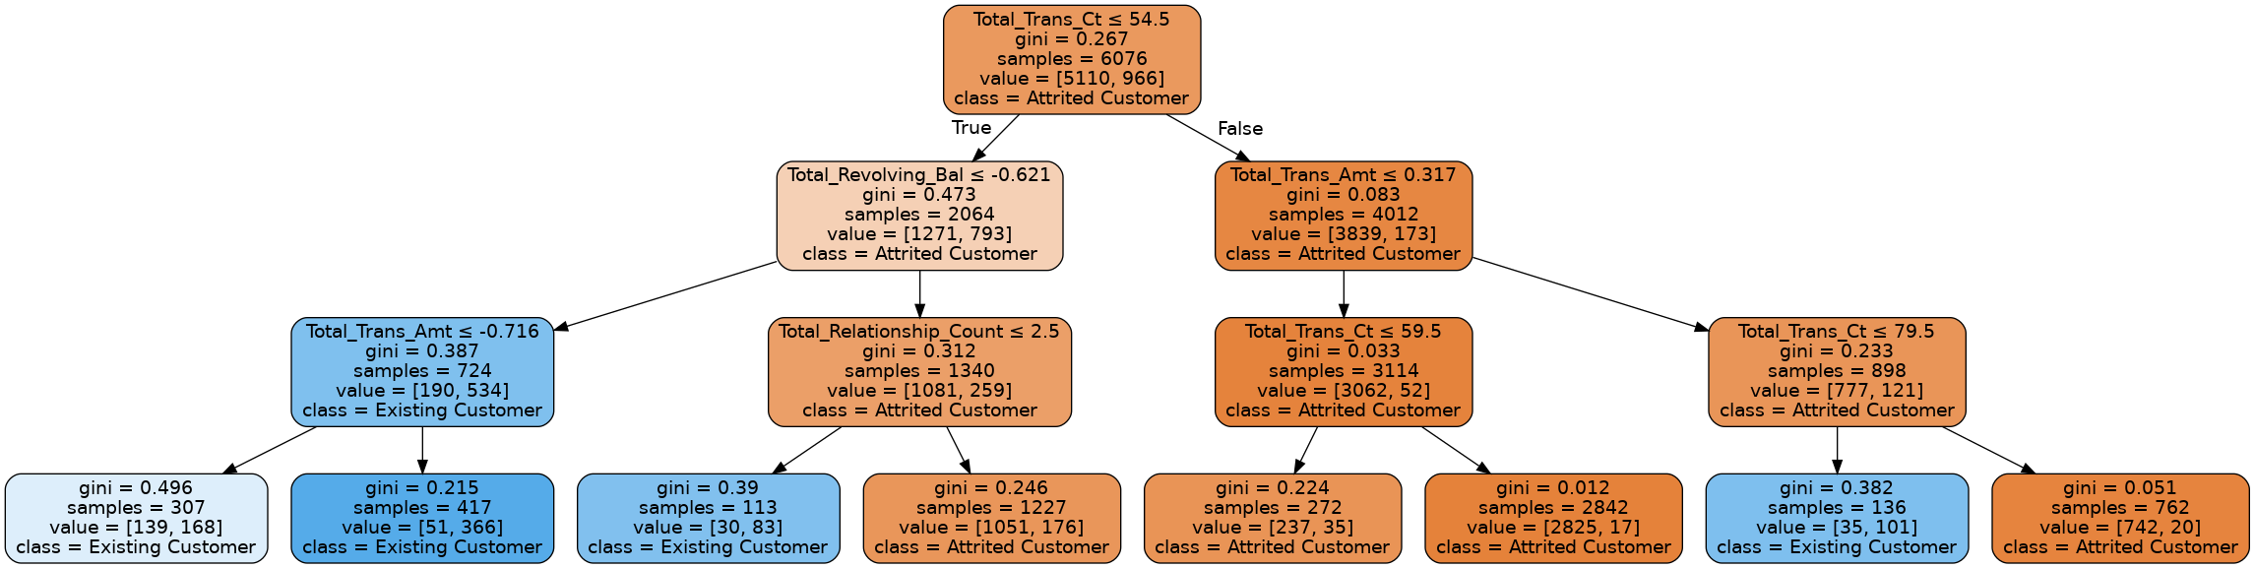
Supervised Learning: Decision Tree Model

Slide 24
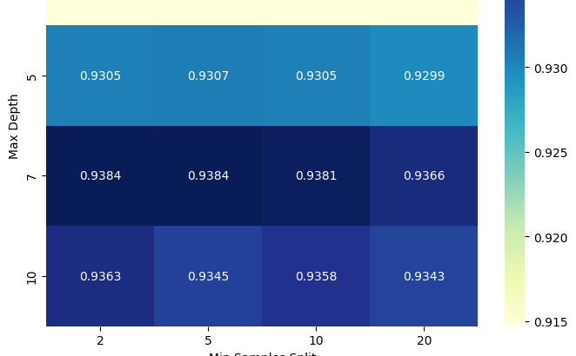
Optimal Range: Grid Search Method
5 or 7
10 to 20
Minimum Sampling Split
Maximum Depth

Slide 25
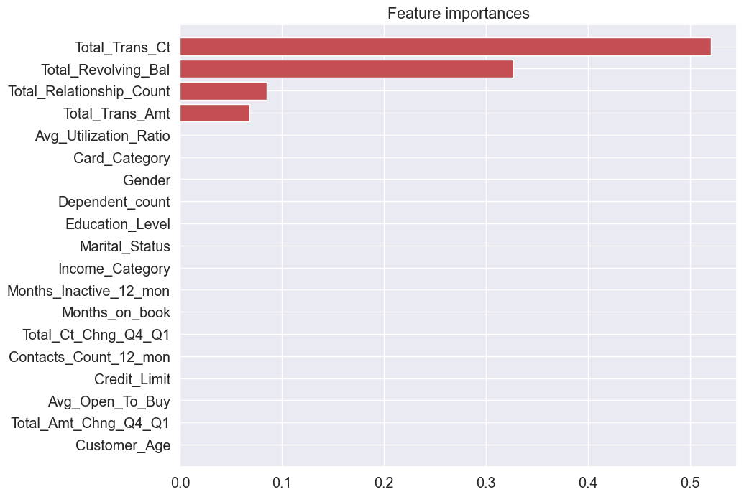
Important Features From Decision Tree

Slide 26
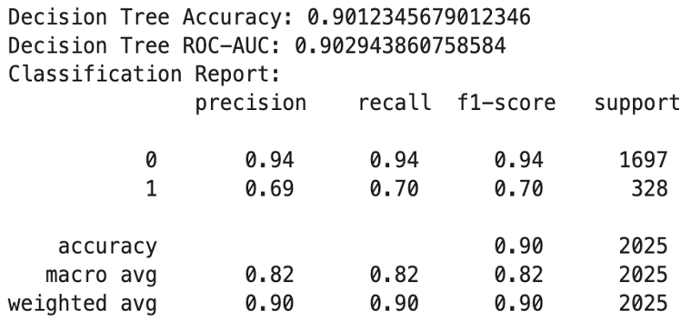
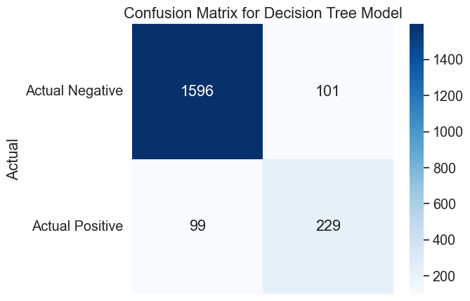
Decision Tree Model Performance
90.12% accuracy in customer retention prediction
90.29% Risk Assessment Capability (ROC-AUC)
Accuracy of Predictions:
94% in identifying secure accounts (class 0)
69% in identifying at-risk accounts (class 1)

Slide 27
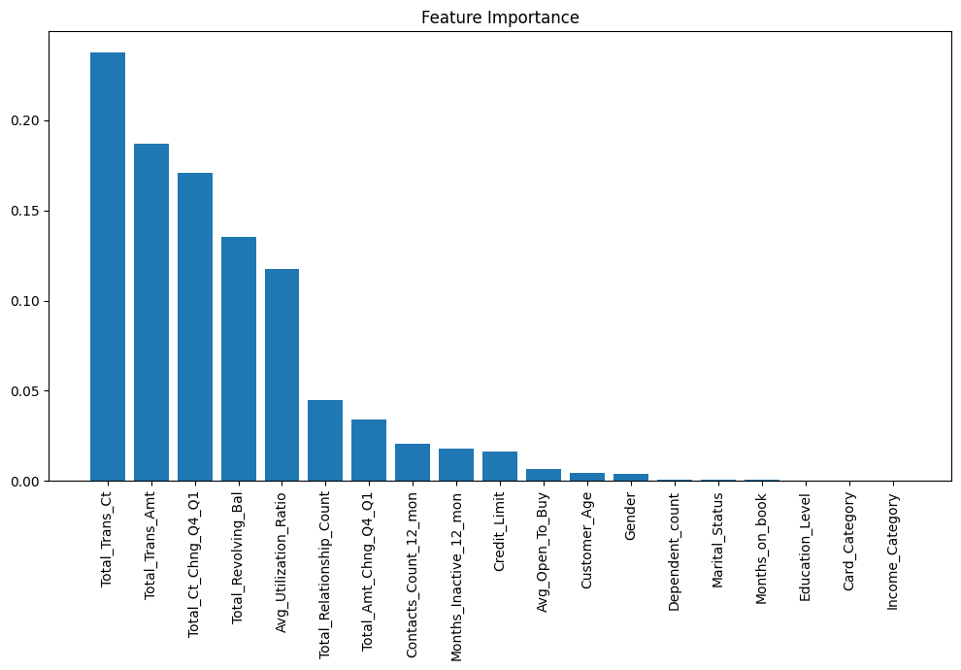
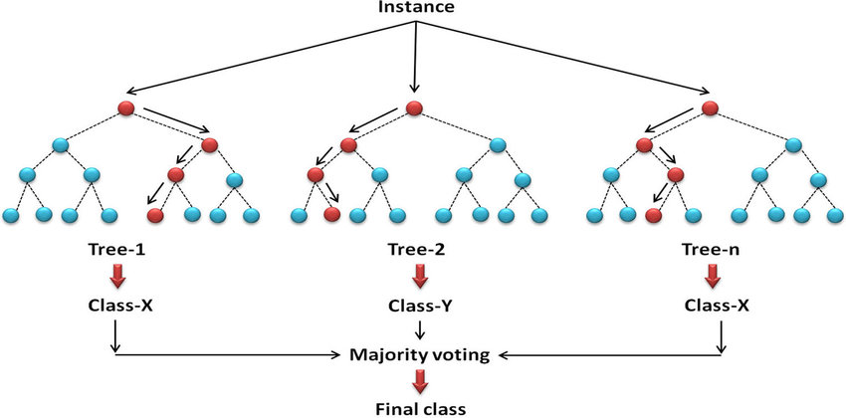
Supervised Learning: Random Forest
The general framework of the random forest (RF) approach.

Slide 28
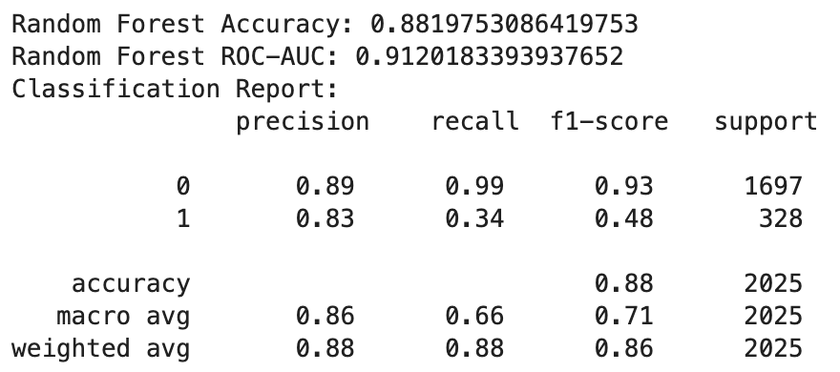
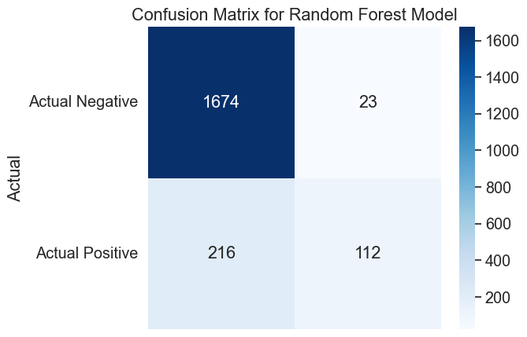
Random Forest Model Performance
Lower accuracy 88.20% (vs. 90.12%)
Higher AUC 91.20% (vs. 90.29% )
Averages results to capture complex relationships
Improves AUC by reducing overfitting
Balances the trade-off with accuracy for reliability

Slide 29
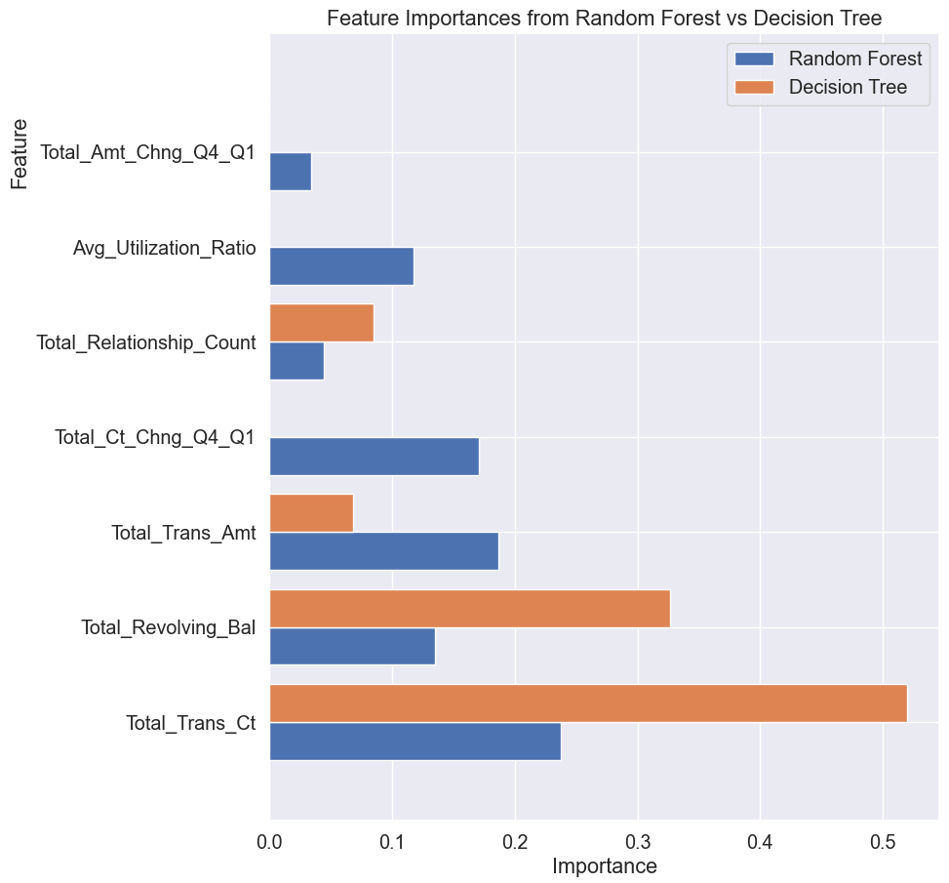
Random Forests vs Decision Trees
Similar top important features
Transaction Count & Amount
Revolving Balance
Number of product held

Slide 30
Performance Comparison
Decision Tree
Random Forest
Simple, follows clear paths, captures easy patterns.
Aggregates multiple trees, reflects diverse data aspects.
Preferred for interpretability and simplicity
Chosen for complexity and capturing varied patterns.

Slide 31
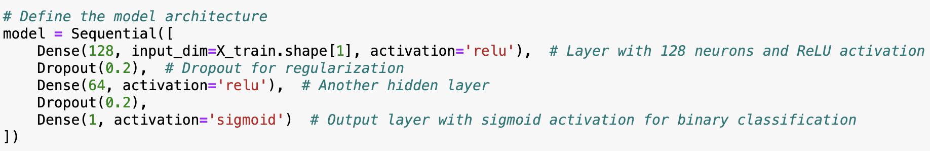
Using Neural Network to predict Attrition Rate
· Use binary_crossentropy as Loss function
· Adam Optimizer with learning rate = 0.001
· Use accuracy as the Metric to evaluate model

Slide 32
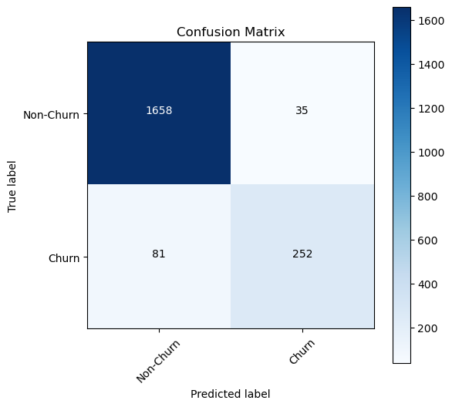
Neural Network Performance
Confusion Matrix:
The matrix shows 1,658 true negatives, where the model correctly predicted 'Non-Churn'.
There are 35 false positives, where the model incorrectly predicted 'Churn' instead of 'Non-Churn'.
The model predicted 'Churn' correctly 252 times, which are true positives.
There are 81 false negatives, where 'Churn' was the true class, but the model predicted 'Non-Churn'.

Slide 33
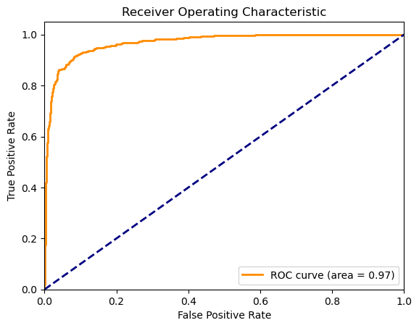
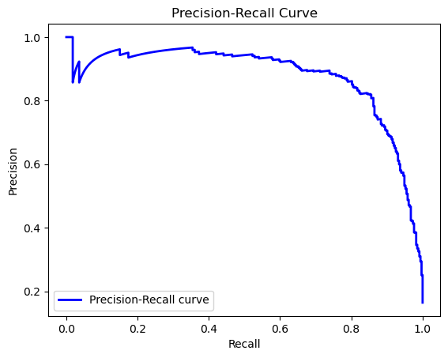
Receiver Operating Characteristic (ROC) Curve:
The ROC curve is close to the top left corner, indicating a high true positive rate and low false positive rate.
The area under the ROC curve (AUC) is 0.97, suggesting the model has excellent discrimination capabilities between 'Churn' and 'Non-Churn'.
Precision-Recall Curve:
The Precision-Recall curve starts with high precision, indicating that initially, when recall is low, the model is very confident in its positive predictions.
The model appears to maintain a high precision until a recall of about 0.8, which is good performance, especially if the positive class ('Churn') is of specific interest and is rarer compared to the negative class ('Non-Churn').

Slide 34
Insights for Action
Focus on Engagement
Campaigns to promote service use and re-engagement
Diverse product range and cross-selling
Improve Customer Service
Well-trained team to resolve customer issues efficiently
Leverage Data
Understand customer needs
Targeted services, e.g., financial advice & balance transfer
Enhance Loyalty Programs
Customers with high Total Relationship Count

Slide 35
References
Gallo, A. (2014, October 29). The value of keeping the right customers. Harvard Business Review. https://hbr.org/2014/10/the-value-of-keeping-the-right-customers
Goyal, Sakshi. (n.d.). Credit Card customers [dataset]. https://leapsapp.analyttica.com/home. Retrieved February 23, 2024, from https://www.kaggle.com/datasets/sakshigoyal7/credit-card-customers
John C. Hull, Machine Learning in Business: An Introduction to the World of Data Science, Independently published (May 26 2021), 979-8508489441Programming language: PYTHON
Images Source
What is so general about Generalized Linear Model? | by Ayan Kundu | Towards Data Science
The general framework of the random forest (RF) approach.

Slide 36
Thank you

